Slide 1
2024 Election – super Tuesday outcomes “story of an election: Super Tuesday version” For : DATA607 – Project 3 March 19, 2024

Slide 2
AGENDA
What and Why: Why this topic and what are our goals
How: Data gathering, transformation, analyses
What they say
Lesson learned

Slide 3
The power of prediction <- What and Why
What
Variety of data for cross-checking: Super Tuesday matters for the outcome of the election and rich data is available
Voter Insight: It reflects the voter behavior and campaign effectiveness
Pattern discovery: Uncover patterns that reveal the electorate’s pulse and the resonating impact of political messaging.
Why:
Voter Turnout: a window to voter’s behaviors
Demographics and how people vote, what resonates with voters, and patterns matter
Data could be used for predictive model (Future work)
Our Goals and Hypothesis:
Data Management: Streamline the collection, cleaning, and organization of data;
Insightful Reporting: Generate detailed statistical summaries and visualizations;
Strategy Assessment: campaign effectiveness by analyzing voter turnout data.
Present summary statistics, and present useful graphs that eventually can be used for a predictive model
Hypothesis to explore: Hypothesis 1: The issue of abortion does not critically sway the election results; Hypothesis 2: For independent voters, the presidential candidate’s age is secondary to their position on abortion.
Notes:
Why we chose this topic, what question we wanted to answer, what we expected to get done, and why it is important (hypothesis and goals)
Your data science project on Super Tuesday is a fascinating choice! Here are some recommendations and help for answering your questions:
Topic Choice: Super Tuesday is a key event in the U.S. political process, offering rich data for analysis. It reflects voter behavior and the effectiveness of political campaigns, making it a valuable study subject.
Key Questions: You might explore which factors influence voter turnout, how demographics affect voting patterns, or the impact of media coverage on election results.
Expected Outcomes: Your team could aim to create predictive models, analyze voter sentiment, or identify key indicators of electoral success.
Importance: Understanding these elements can provide insights into democratic processes and inform future political strategies. Your hypothesis might focus on the predictive power of certain variables, with goals to enhance the accuracy of election forecasting.

Slide 4
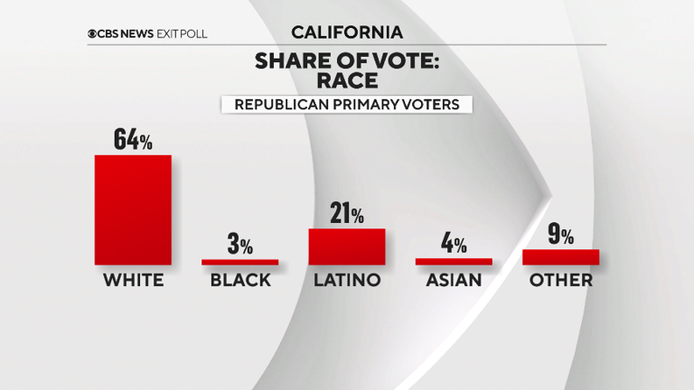
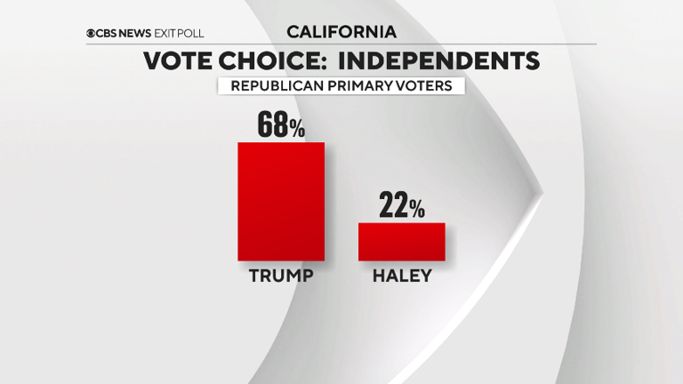
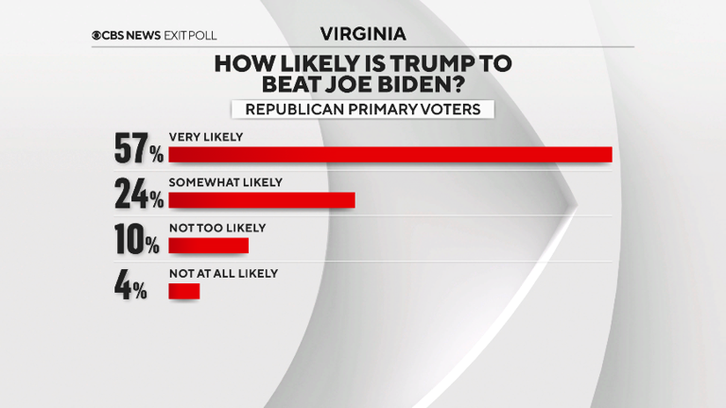
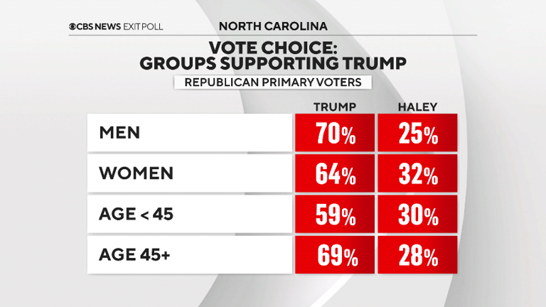
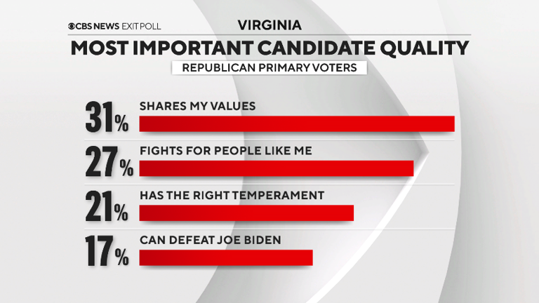
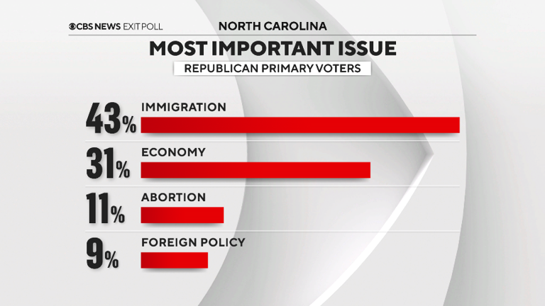
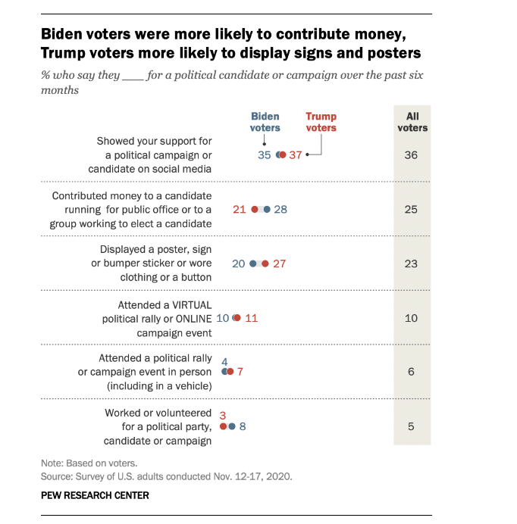
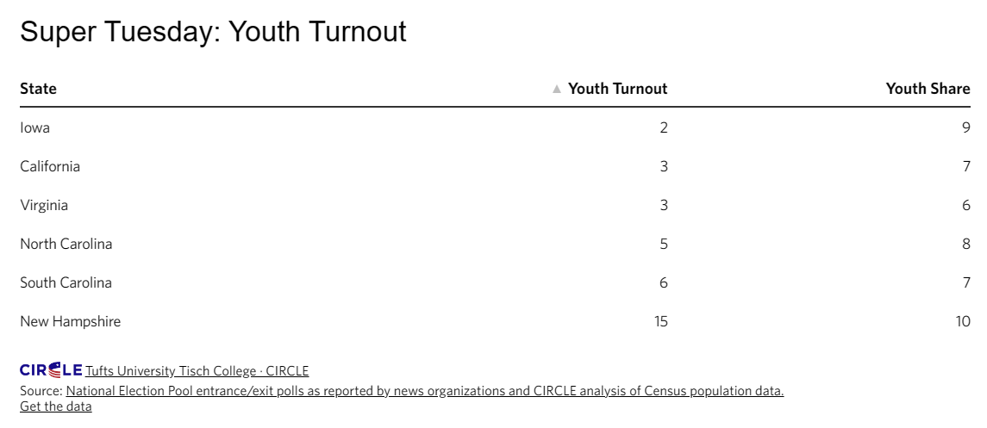
What others do?
Notes:
Super Tuesday exit polls and analysis for the 2024 primaries (msn.com)
Super Tuesday: Youth Turnout Low in North Carolina, Virginia, and California | CIRCLE (tufts.edu)
Key findings about voter engagement in the 2020 election | Pew Research Center

Slide 5
How: How we gather the data
What data we gathered, how they look like, and what is different in this data
How we organized them and why this way sample of code and output results

Slide 6
How: How we gather the data
What part of the data was complex, and how we tackle the complexity to achieve our goal, how we achieve our goal

Slide 7
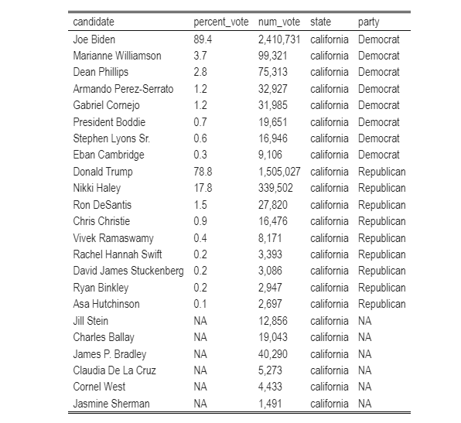
Observations and analyses
Tabulated data: The largest proportion to grab is Nikki Haley’s, who can attract them, and how? What matters to them?
Only in two states of super Tuesday Democrats turn out were higher than Republicans, on the rest Republicans were decisively more

Slide 8
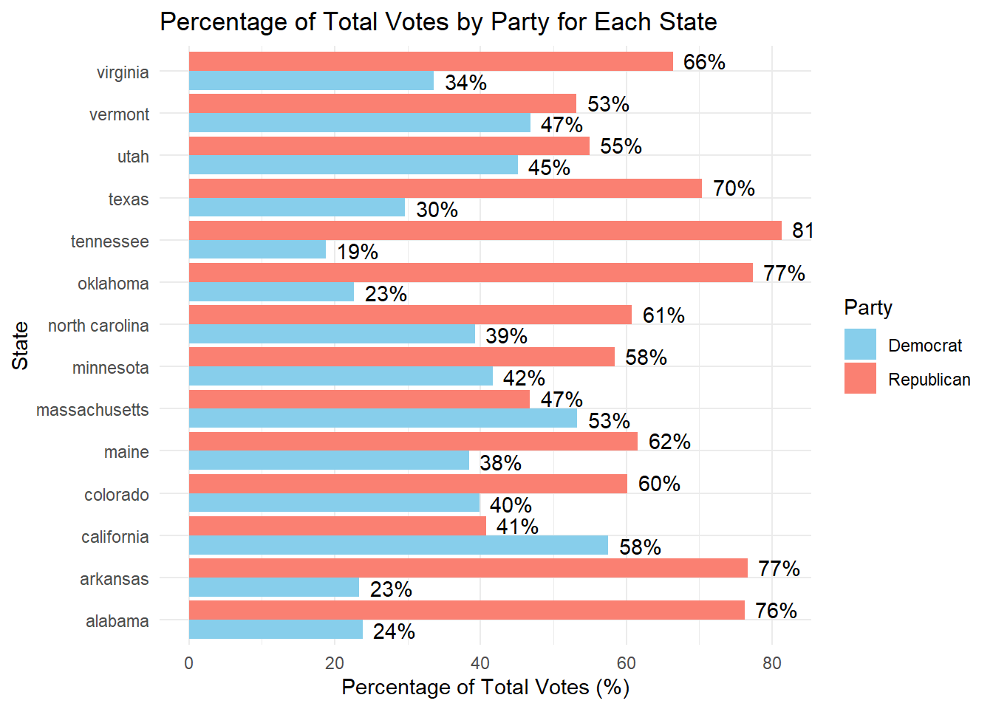
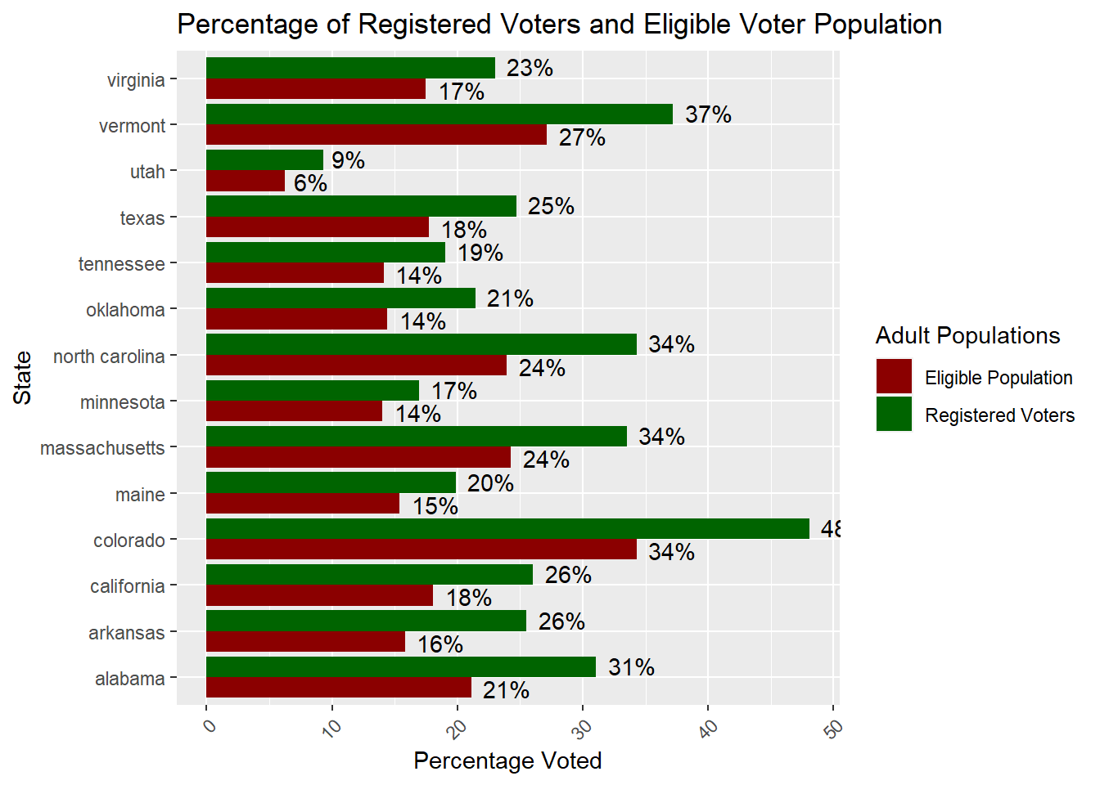
What State matters
States that voter may matter: Vermont, Utah, Massachusetts, (difference below 10%)
Registered vs total, what kind of inference we can make?
Notes:
Appears to enthusiasm in current republicans, but some in the margin of error can be flipped back
Majority of voter didn ot came out yet, only third elecyt the presudemt

Slide 9
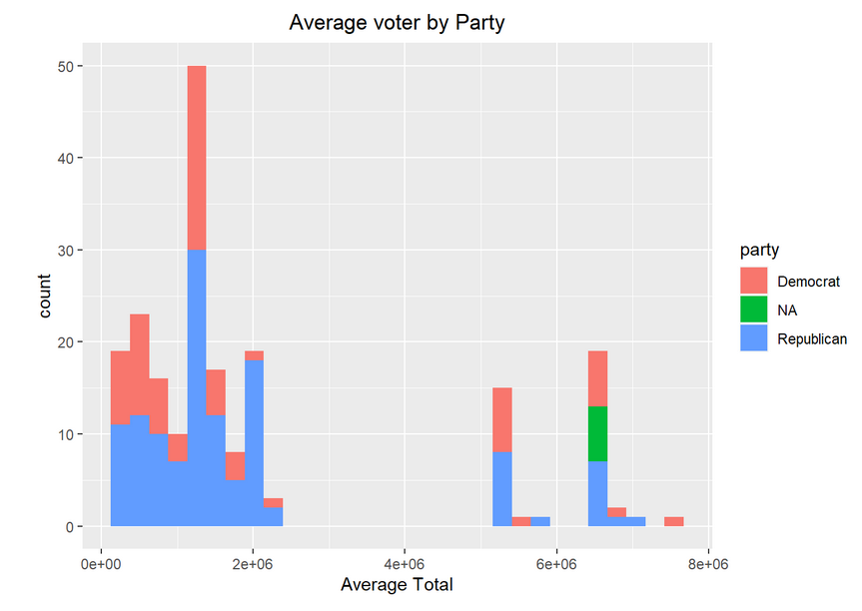
What conclusion we can make of Average voter?

Slide 10
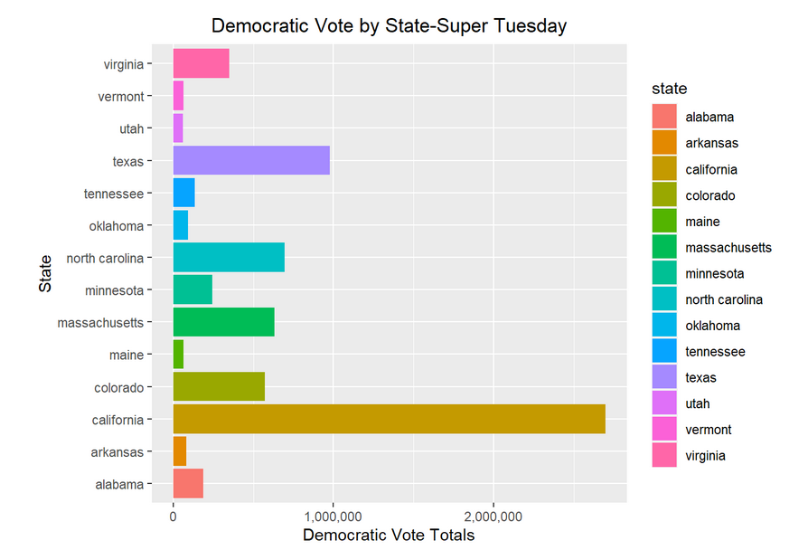
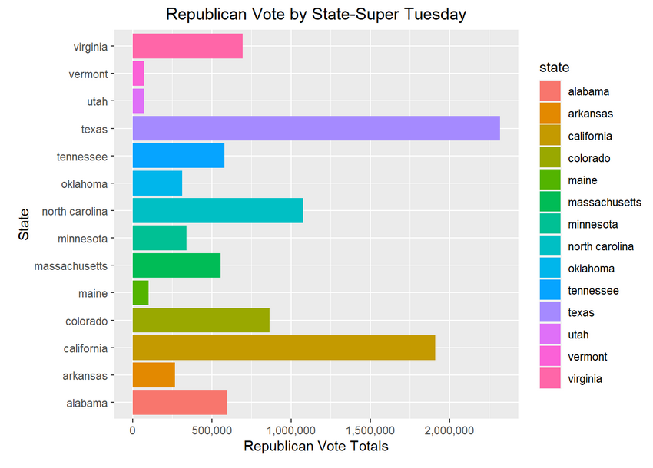
Voter Turnout – What data says about enthusiasm?
Notes:
See the state in California even it is Democratic, there were a lot enthisiam in the republican, not unpecident of the stae , and vermon or massaachussets

Slide 11
Results: What results say
Three conclusions as Anthony said for the conclusion
Turnout may change the election, people wait and see to come out later!
We are not looking into independent voters yet, an invariable that can change the entire election results!
Polling is not great!
Future study:
Look into independent voter, have an investigation into what parameters can affect Haley’s voter to one or another candidate

Slide 12
Lesson learned
Don’t get into politics!
Working in a tram requires planning and dedication, people have different interests and strengths, takes time to figure out who does what good.
Have a plan, see what others do, and learn from it to plan your analyses
Good data is available but getting them and organizing them is difficult, and requires extra attention, and understanding of the structure of the data
Notes:
What is our take from he project, what would we do differently, what we did well, and what we have learned

Slide 13
Sources & Referecnes
[1]: GitHub: https://github.com/kohyarp/DATA607_Project3
[2]: Rpub: https://rpubs.com/kohyarp/1163803
[3]:https://electionlab.mit.edu/articles/voter-confidence-and-electoral-participation
[4]: https://time.com/6223871/midterms-voting-turnout-results/
[5]:https://escholarship.org/content/qt83s3p2t2/qt83s3p2t2_noSplash_5f3d629c82c3feb4af00babba1b97e8d.pdf
[6]: Ballotpedia’s Super Tuesdayprimaries(https://ballotpedia.org/Super_Tuesday_primaries,_2024)
[7]: worldpopulationreview(https://worldpopulationreview.com/state-rankings/registered-voters-by-state).

Slide 14
THANK YOU
Team:
Anthony C. , James N, Koohyar P., and victor T.

